Slide 1
Exception
Software interrupt
Automatically occurring trap.
No specific instruction associated with exceptions.
Example: division by zero.
Whenever an exception is raised, the CPU temporarily suspends the program it was executing and starts the ISR. ISR will contain what to do with the exception.
It may Correct the problem Or it may abort the problem by raising some message.

Slide 2
Trap
Trap is also a software interrupt.
Is an instruction that explicitly generates an exception condition.
The most common use of trap is to enter supervisor mode.

Slide 3
Co- processors
Are attached to the CPU and implement some of the instructions.
Floating point arithmetic was introduced into the Intel architecture by providing separate chips that implemented the floating point instructions.
When the CPU receives a co processor instruction, the CPU must activate the co processor and pass it the relevant instruction.
The ARM architecture provides support for up to 16 co processors attached to a CPU.
To support co-processors, certain opcodes must be reserved in the instruction set for co-processor operations

Slide 4
Memory system mechanism
Caches
Accesses in the cache will be fast
Small, fast memory that holds copies of some of the contents of main memory.
Since it is small not all requests can be satisfied by the cache.
The cache controller sends a memory request to the cache and main
memory.
Cache hit, cache miss.

Slide 5
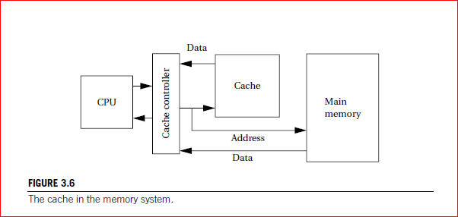

Slide 6

some basic formulas for memory system performance
Let h be the hit rate, the probability that a given memory location is in the cache.
1-h is the miss rate, the probability that the location is not in the cache.
tcache is the access time of the cache.
tmain is the main memory access time.
The best-case memory access time (ignoring cache controller overhead) is
while the worst-case access time is

Slide 7
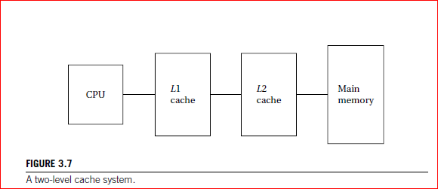
Modern CPUs may use multiple levels of cache.
The second-level cache is much larger but is also slower.

Slide 8
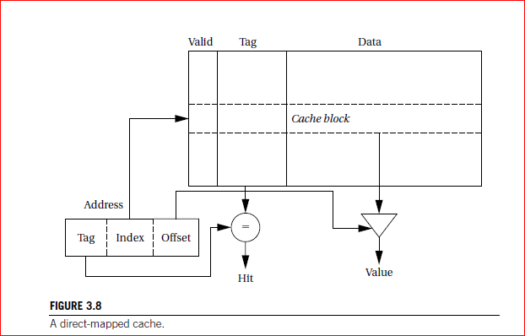
The simplest way to implement a cache is a direct-mapped cache,

Slide 9
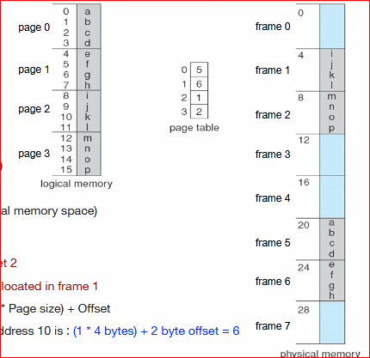

Slide 10
Writes are slightly more complicated than reads because we have to update main memory as well as the cache.
The simplest scheme is known as write-through.
every write changes both the cache and the corresponding main memory location but may generate some additional main memory traffic.
We can reduce the number of times we write to main memory by using a write-back policy.
we write only when we remove a location from the cache.

Slide 11
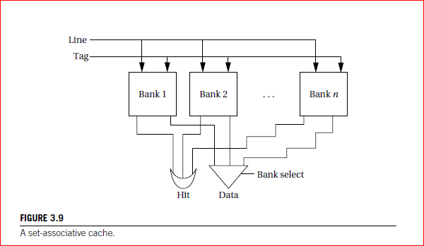
A set-associative cache.

Slide 12
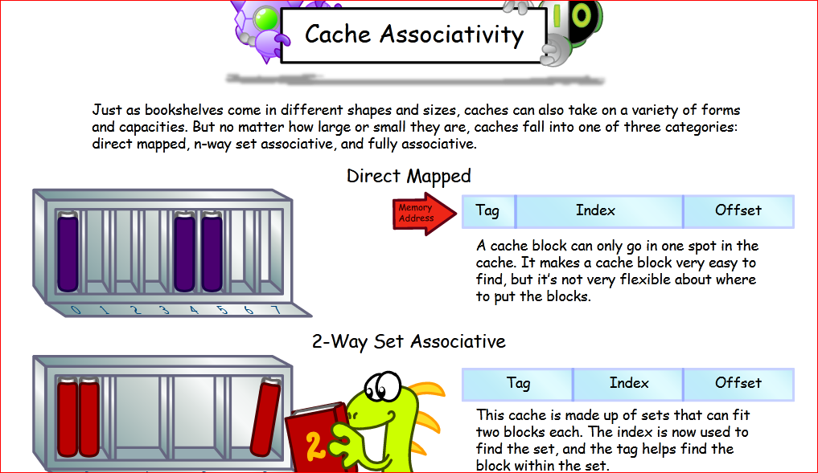

Slide 13
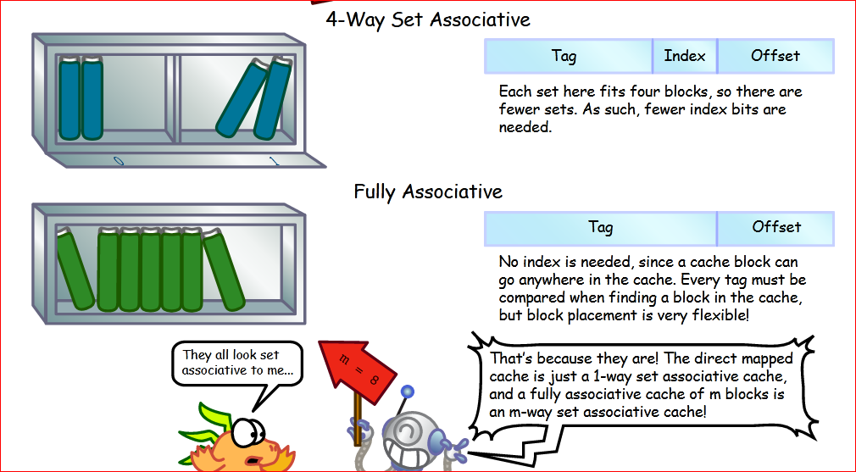

Slide 14
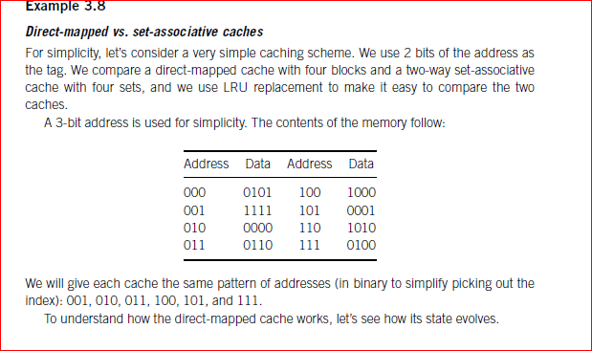
Study yourself

Slide 15
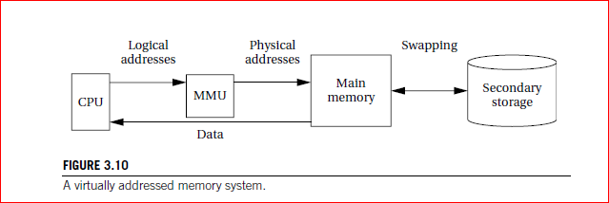
Memory Management Units and Address Translation
A MMUtranslates addresses between the CPU and physical memory.
This translation process is often known as memory mapping.

Slide 16
When the CPU requests an address that is not in main memory, the MMU generates an exception called a page fault.
loading a location into main memory will usually require throwing
something out of main memory. The displaced memory is copied into secondary storage before the requested location is read in. As with caches, LRU is a good replacement policy.

Slide 17
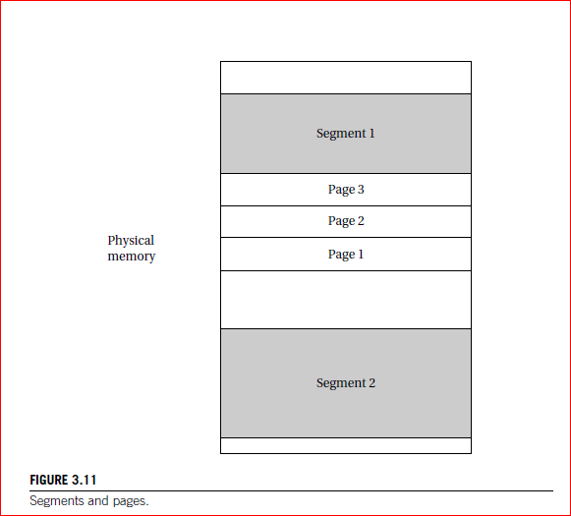

Slide 18
A segment is usually described by its start address and size, allowing different segments to be of different sizes.
Pages are of uniform size, which simplifies the hardware required for address translation.

